Slide 1
Something new:
ArrayList Class
Mr. Neat
Java

Slide 2

What are the limitations of
an array?

Slide 3
Limitations of arrays
Cannot be resized!

Slide 4
java.util.ArrayList is the
library class that must be
imported.

Slide 5
import java.util.ArrayList;
public class PlayArray
{
private ArrayList<Object> myList = new ArrayList<Object>();
constructs an ArrayList object
with zero elements

Slide 6
import java.util.ArrayList;
public class PlayArray
{
private ArrayList<Object> myList = new ArrayList<Object>();
can put any class in here
constructs an ArrayList object
with zero elements

Slide 7
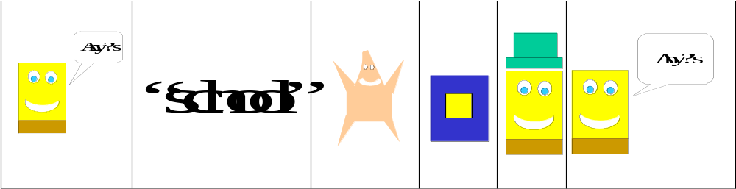
public ArrayList Methods
int size()
boolean add(Object x)
Object get(int index)
Object set(int index, Object x)
Object remove(int index)
void add(int index, Object x)
myList.size()
myList.add(“Hi”);
myList.get(4);
myList.set(3,”Bye”);
myList.remove(2);
myList.add(3,new SpongeBob….);
myList

Slide 8
import java.util.ArrayList;
public class PlayArray
{
private ArrayList<String> myList2 = new ArrayList<String>();
can put any class in here
constructs an ArrayList object
with zero elements

Slide 9
public ArrayList Methods
int size()
boolean add(String x)
String get(int index)
String set(int index, String x)
String remove(int index)
void add(int index, String x)
myList2.size()
myList2.add(“Hi”);
myList2.get(4);
myList2.set(3,”Bye”);
myList2.remove(2);
myList2.add(3,new SpongeBob….);
myList2 (holds Strings)
“hello”
“school”
“Hi”
“Bye”
“I”

Slide 10
Don’t Forget the for each loop!
for(String s: myList2)
{
SOP(s);
}

Slide 11
Don’t Forget the for each loop!
for(String s: myList2)
{
SOP(s);
}
Simpler notation – no need to call .get(i)

Slide 12
How does the ArrayList
resize?

Slide 13
One problem…
what if we wanted an
ArrayList of ints, booleans or doubles (primitives)?
But ArrayList holds Classes!

Slide 14
Wrapper Classes to the rescue!
These classes turn primitive
types into classes. We are
concerned about 3:
Double
Int
Boolean

Slide 15
Construct a Double object:
Double r = new Double(7.5);
// to retrieve the double value,…
System.out.print(r.doubleValue());

Slide 16
Let’s add a Double value to
aList:
ArrayList<Double> aList = new ArrayList<Double>();
double num = 37.5;
Double numWrap = new Double(num);
aList.add(numWrap);

Slide 17
How would you retrieve
the Double in aList?
Now its an Object….

Slide 18
Double retriever = aList.get(0);
double back = retriever.doubleValue();

Slide 19
Lab
Make an ArrayList of Cars
Store 100 Cars in the ArrayList
Make them recycle

